Slide 1

Data Security
M2-D8
Participate! The more engagement the better! You are NEVER interrupting me!

Slide 2

This lecture comes with a disclaimer:
https://www.ncsl.org/research/telecommunications-and-information-technology/computer-hacking-and-unauthorized-access-laws.aspx

Slide 3
Objectives
Data Breaches
SQL Injection
Hashing
Encryption

Slide 4
World’s Biggest Data Breaches
https://www.informationisbeautiful.net/visualizations/worlds-biggest-data-breaches-hacks/ https://www.informationisbeautiful.net/visualizations/top-500-passwords-visualized/ https://informationisbeautiful.net/visualizations/ransomware-attacks/
Steal sensitive information
Bypass authentication
Gain elevated privileges
Add/Delete data
Gain access to operating system shell access
Using the database to launch sophisticated attacks

Slide 5
SQL Injection
SQL injection occurs when untrusted data such as user data from application web pages are added to database queries, materially changing the structure and producing behaviors inconsistent with application design or purpose.
SQL injection is by far the most dangerous vulnerability impacting online applications today

Slide 6
Types of SQL Injection
Query Modification
The attacker modifies the original query and then Ignores the rest of the original by adding -- at the end of their addition to comment it out.
Union Attack
The attacker creates a UNION with an existing query that returns results from their query mixed with results of a legitimate query. (https://portswigger.net/web-security/sql-injection/union-attacks)
Stacked Queries
The attacker ends the original query with a ; and then appends their own query onto the original..

Slide 7

SQL Injection
firstName lastName
String sql = “INSERT INTO PERSON VALUES(“ + firstName + “, “‘; delete from users; --”;
‘; delete from Users; --
This will delete every user in the Users table! And if I can get one command to work, I can get ANY valid SQL command to work.

Slide 8
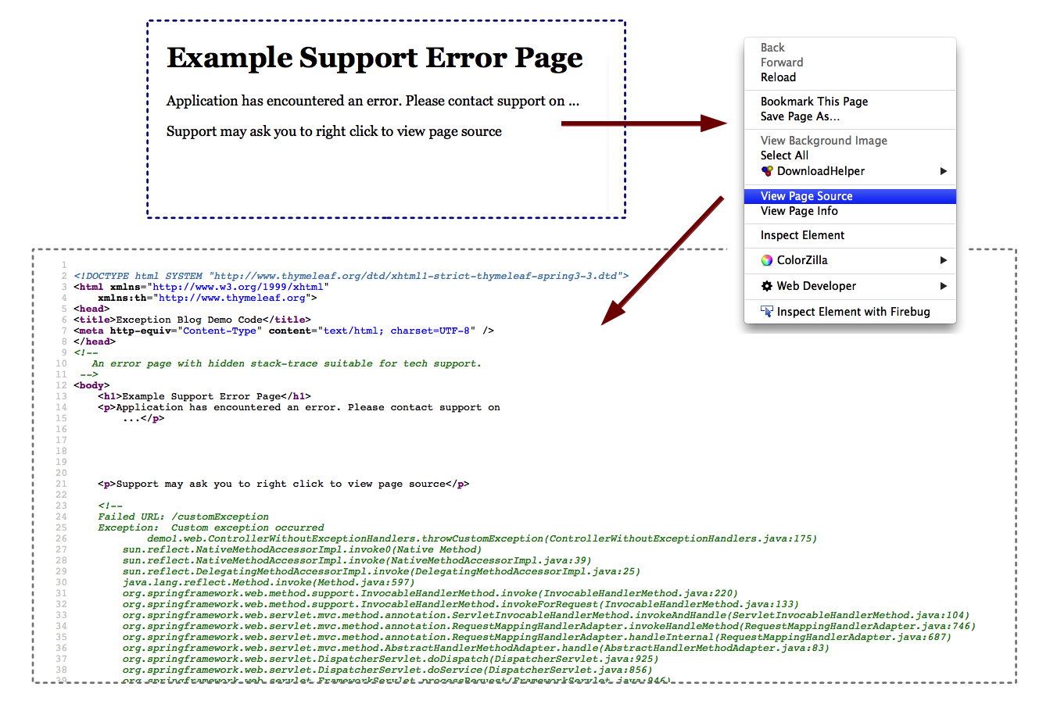
Stack Trace Errors
Not exact to what you might see but close:

Slide 9
Example Code

Slide 10
How To Prevent SQL Injection
Use parameterized queries! String sqlQuery = "INSERT INTO person (id, firstName, lastName) VALUES(?, ?, ?)";
Input Validation - Can be helpful but not usually enough
Limit Database User Privileges
If you use parameterized queries, it is impossible to do SQL injection

Slide 11
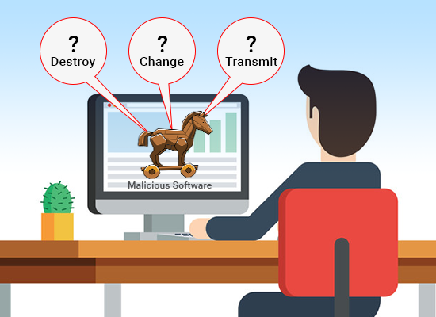
SQL Injection
And what would happen if I SQL-injected Javascript code? HINT: Javascript runs in a browser

Slide 12
Fun Link To Learn More
https://www.hacksplaining.com/

Slide 13
Hashing
A hashing algorithm is a mathematical function that condenses data to a fixed size. So, for example, if we took the sentence “The Quick Brown Fox Jumps Over The Lazy Dog” and ran it through a specific hashing algorithm known as CRC32 we would get “07606bb6” –this result is known as a hash.
MD5 and SHA-1 are two commonly used hashing algorithms
http://onlinemd5.com/
Hashing is a ONE-WAY meaning once a value is hashed, you can’t go back the other way. It is commonly used to store passwords

Slide 14
Dictionary Attacks
Dictionary attacks are a technique used by hackers to take map common passwords with their hashed values using the common algorithms. Because password dictionaries exist all over the Internet, this makes passwords that have been hashed vulnerable to guesses. Salting is a technique that reduces the effectiveness of dictionary attacks by making all input values for passwords unique. (Next slide)

Slide 15
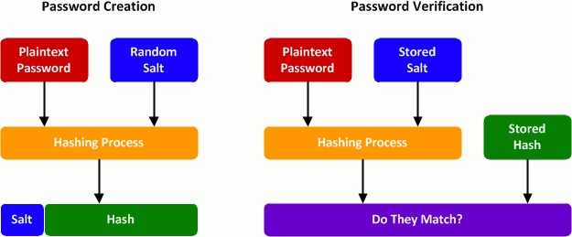
Salting
A Salt is a fixed-length cryptographically-strong random value that is added to a password as input to a hash function.

Slide 16
Encryption
Encryption is the most effective way to achieve data security. When data is sent between two parties or stored, it is stored in an encrypted non-human readable format that requires the key to properly decrypt and understand.
OWASP Guide to Cryptography

Slide 17
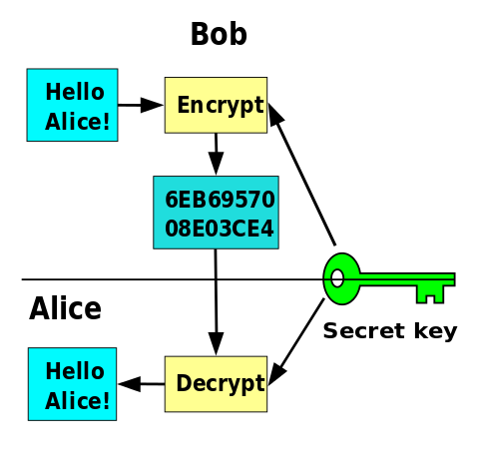
Encrypting Data at Rest
Data at rest can use a form of encryption called symmetric key encryption
Requires both parties to use the key to encrypt and decrypt data.
Any party possessing the key can read the data.
Has difficulties securing the symmetric key amongst multiple parties.
Symmetric cryptography involves the parties sharing a common secret passphrase or key. Data is encrypted and decrypted using the same key.

Slide 18
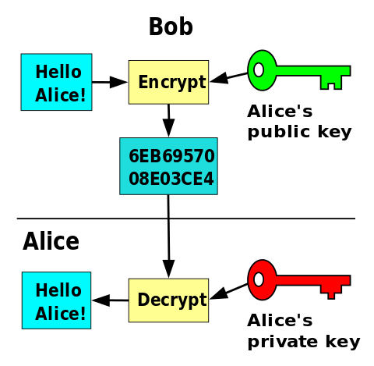
Securing Data in Transit
Data in transit can use a form of encryption called asymmetric key encryption
Uses a Private and Public Key
Any party can be sent the public key. It can encrypt the data, but not decrypt it.
Only the key owner has the private key. It can decrypt data encrypted by the public key.
Has difficulties securing the symmetric key amongst multiple parties.
Asymmetric cryptography uses two keys: one to encrypt the data and the other to decrypt.
More Details on how the Algorithms work

Slide 19
Asymmetric Encryption Common Usages
Communication/Network Security: Digital Certificates
Normally a paid subscription
OpenSSL - Open Source / Free Certificates
Web: HTTPS (SSL (Secure Socket Layer) /TLS (Transport Layer Security) )
HTTPS Everywhere Project - movement to make all communication on the internet encrypted using OpenSSL
Java: Bouncy Castle
open source library that provides asymmetric encryption for Java

Slide 20
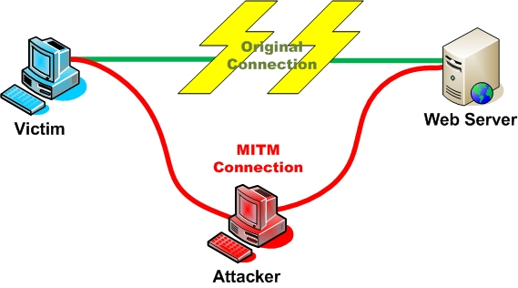
Man In the Middle Attack
Performed by a local malicious network connection, for example, in a coffee shop or hotel.
Attacker provides a fake wifi connection
Victim connects and establishes a secure connection with the fake wifi connection.
The attacker establishes a secure connection on behalf of the victim to the intended destination.
Communication then transmits encrypted from the user to the attackers device and from the attackers device to the destination, but is unencrypted while on the attackers device.

